Slide 1
Module 13 Guided Lab - Implementing a Serverless Architecture with AWS Lambda
Made for Professor Lanham A. by Amrit Singh

Slide 2
AGENDA
Accessing the AWS management console
Task 1: Creating a Lambda function to load data
Task 2: Logging in as Nikhil and testing access
Task 3: Configuring IAM for database administrator user access
Task 4: Logging in as the database administrator and resolving the database connectivity issue
Task 5: Using the IAM Policy Simulator and creating a custom IAM policy with the visual editor

Slide 3
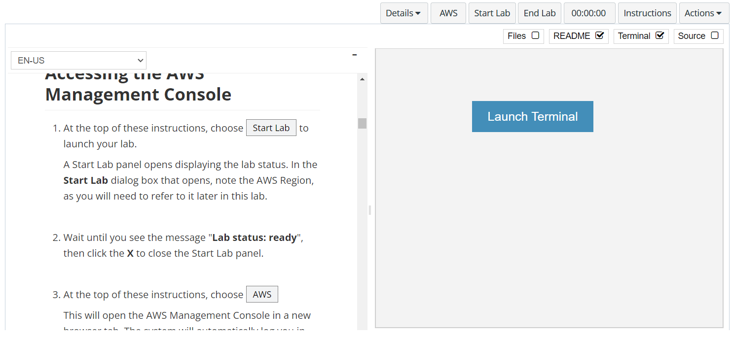
In aws labs click on start lab

Slide 4
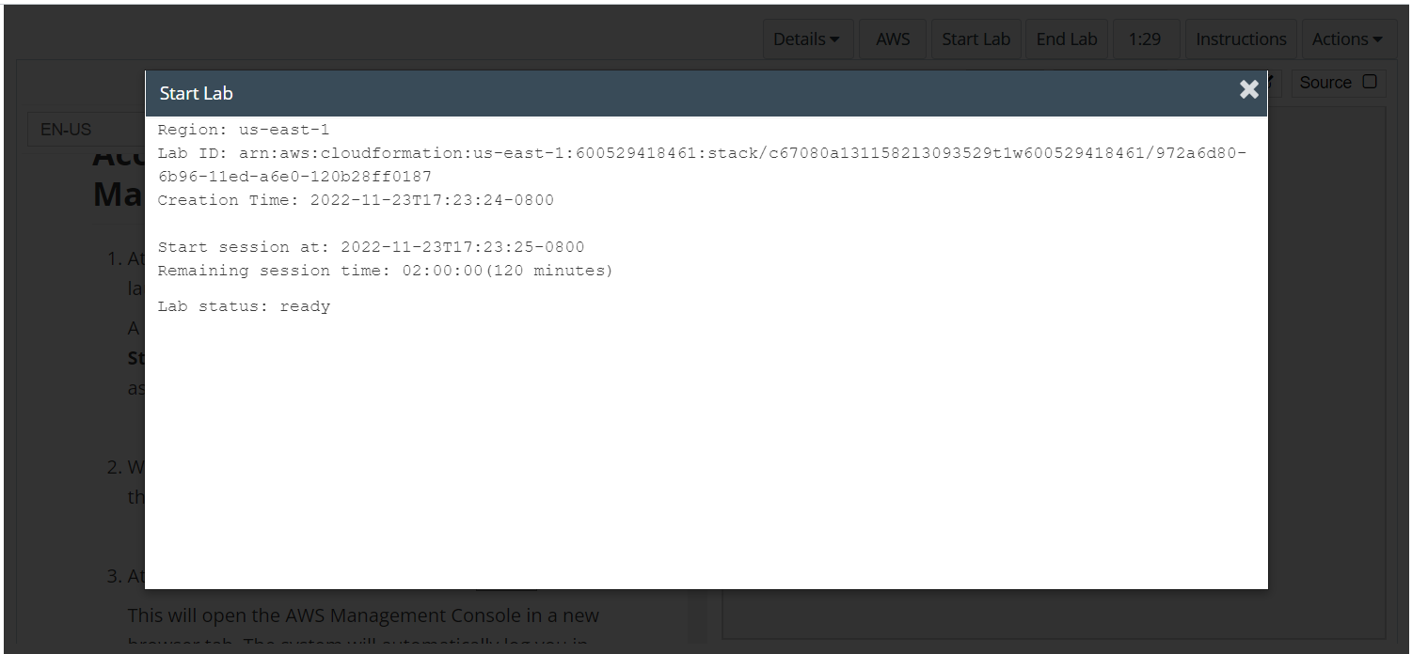
Wait to see lab ready status in the window then press x and click on aws to launch console

Slide 5
Task 1: Creating a Lambda function to load data

Slide 6
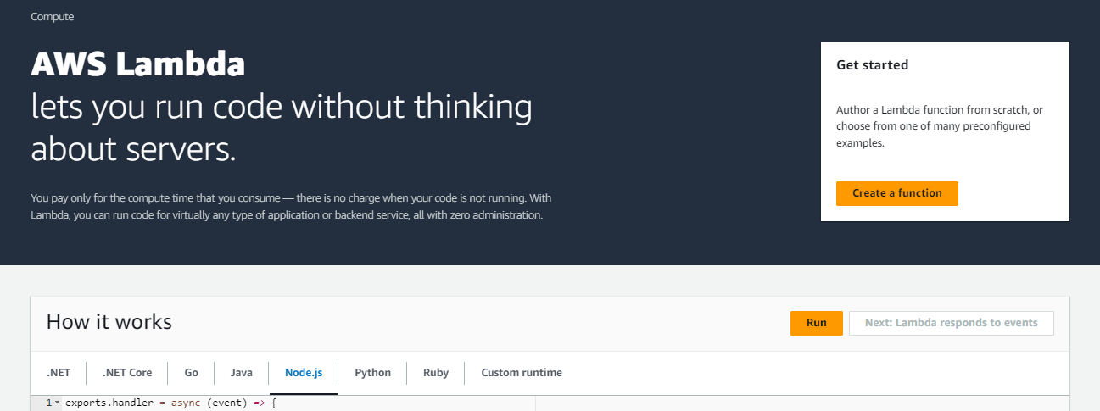
OPEN THE LAMBDA CONSOLE
In the AWS Management Console, on the Services menu, choose Lambda.
Choose Create function

Slide 7
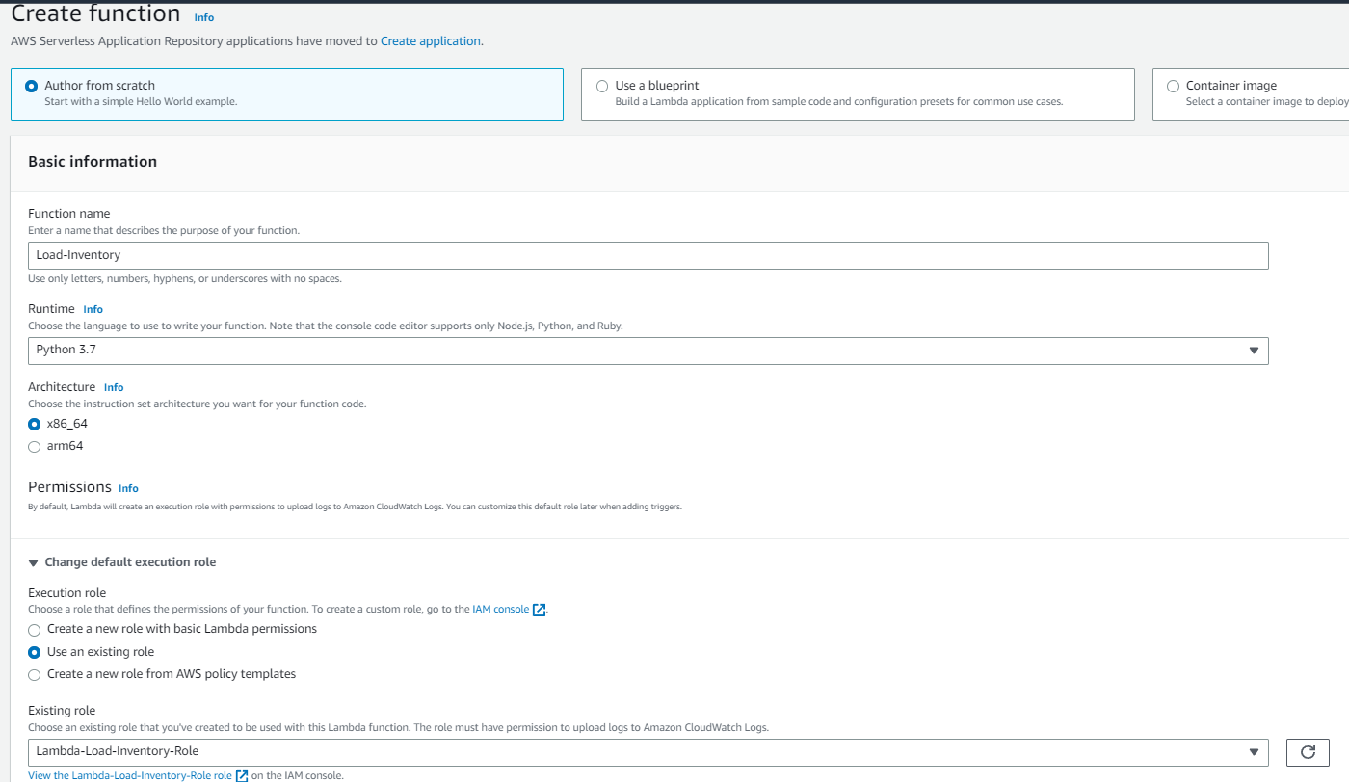
CREATE THE FOLLOWING LAMBDA FUNCTION
Configure the following settings:
Function name: Load-Inventory
Runtime: Python 3.7
Expand Choose or create an execution role.
Execution role: Use an existing role
Existing role: Lambda-Load-Inventory-Role
Choose Create function

Slide 8
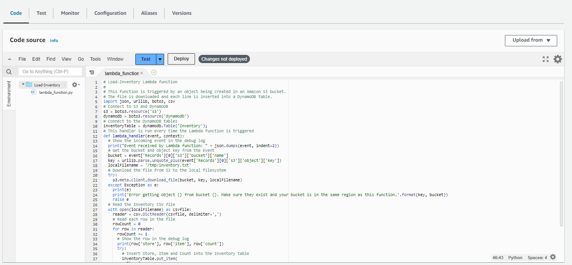
CONFIGURE THE CODE FROM AWS LABS IN THE LAMBDA CODE
Scroll down to the Code source section, and in the Environment pane, choose lambda_function.py.
In the code editor, delete all the code.
In the Code source editor, copy and paste the following code from AWS LABS
Choose Deploy to save your changes.

Slide 9
Task 2: Configuring an Amazon S3 event

Slide 10
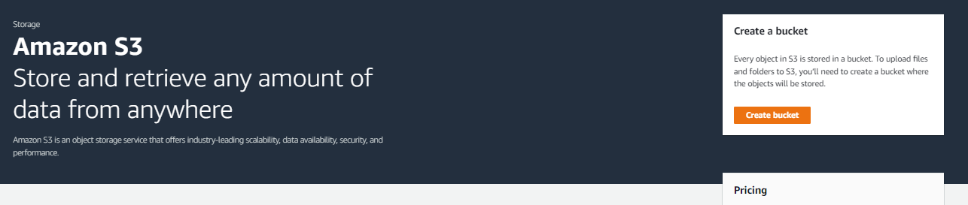
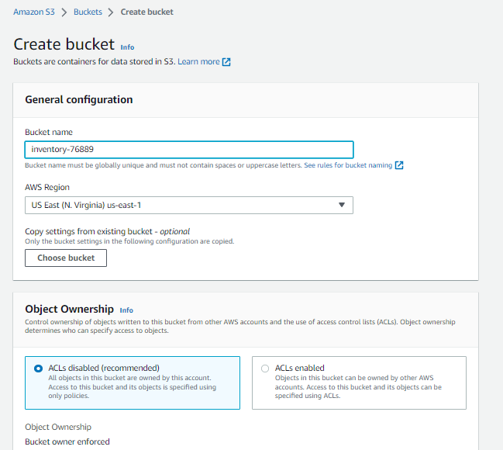
Open the s3 console
On the Services menu, choose S3.
Choose Create bucket
For Bucket name enter: inventory-<number> (Replace with a random number)
Choose Create bucket

Slide 11
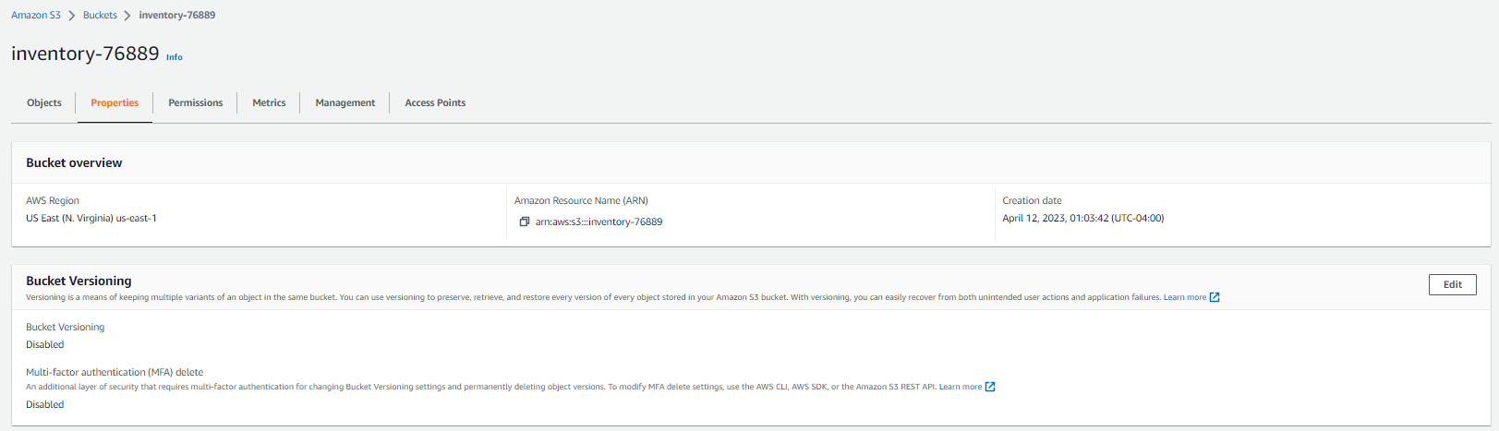
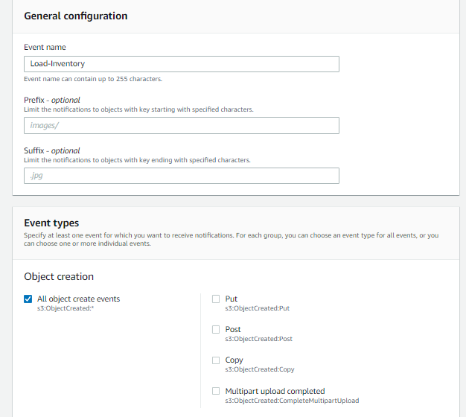
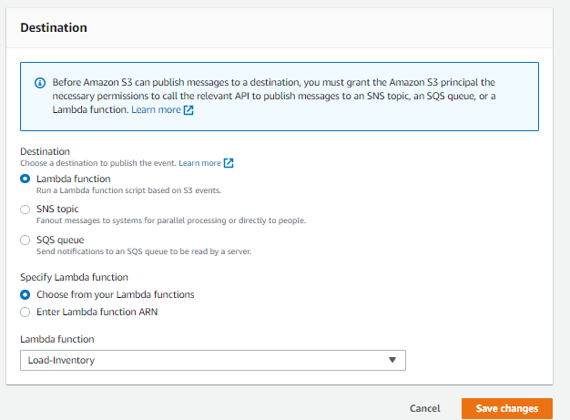
Open the properties of the bucket
Choose the name of your inventory- bucket.
Choose the Properties tab.
Scroll down to Event notifications.
You will configure an event to trigger when an object is created in the S3 bucket.
Click Create event notification then configure these settings:
Name: Load-Inventory
Event types: All object create events
Destination: Lambda Function
Lambda function: Load-Inventory
Choose Save changes

Slide 12
Task 3: Testing the loading process

Slide 13
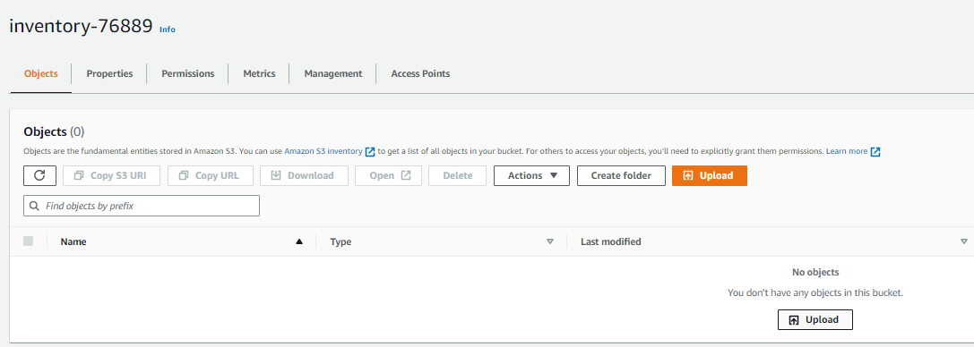
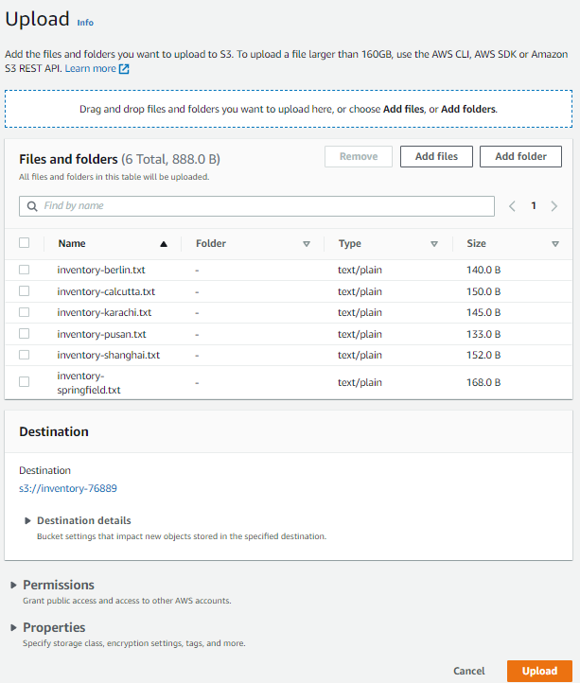
Download the files from aws labs and then upload them to s3
Download the inventory files by opening the context (right-click) menu
In the console, return to your S3 bucket by choosing the Objects tab.
Choose Upload
Choose Add files, and select one of the inventory CSV files. (You can choose any inventory file.)
Choose Upload

Slide 14
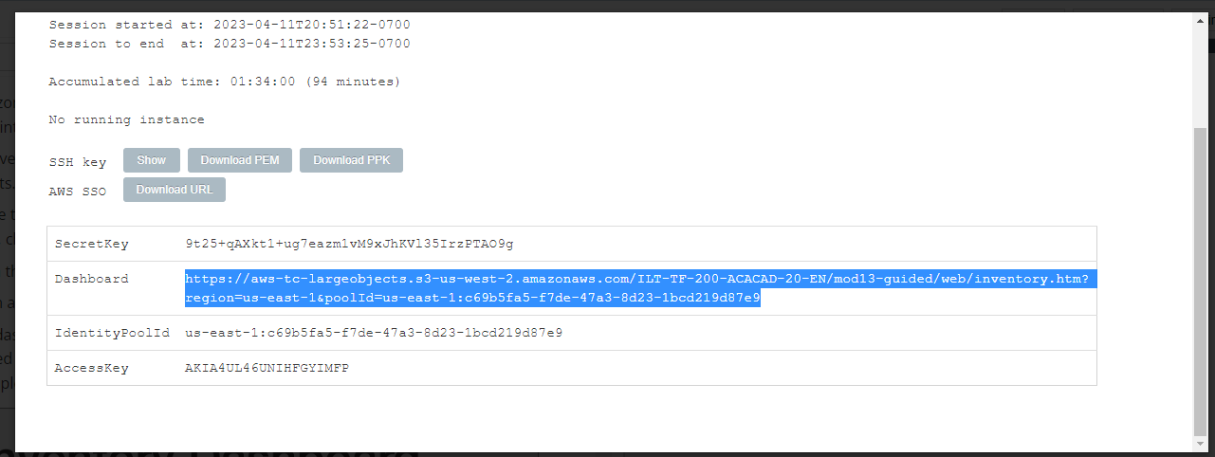
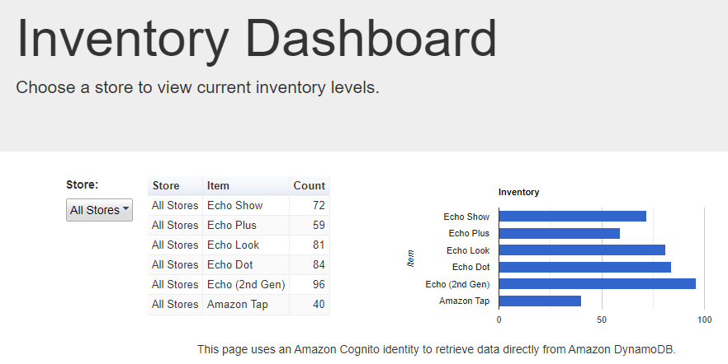
Open the url from the link in the details button
At the top of these instructions, choose the Details button, and to the right of AWS, choose the Show button.
From the Credentials window, copy the Dashboard URL.
Open a new web browser tab, paste the URL, and press ENTER.

Slide 15
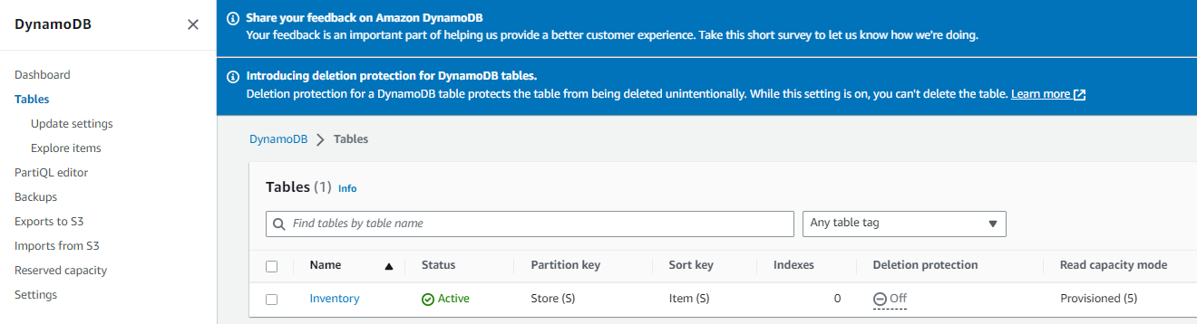
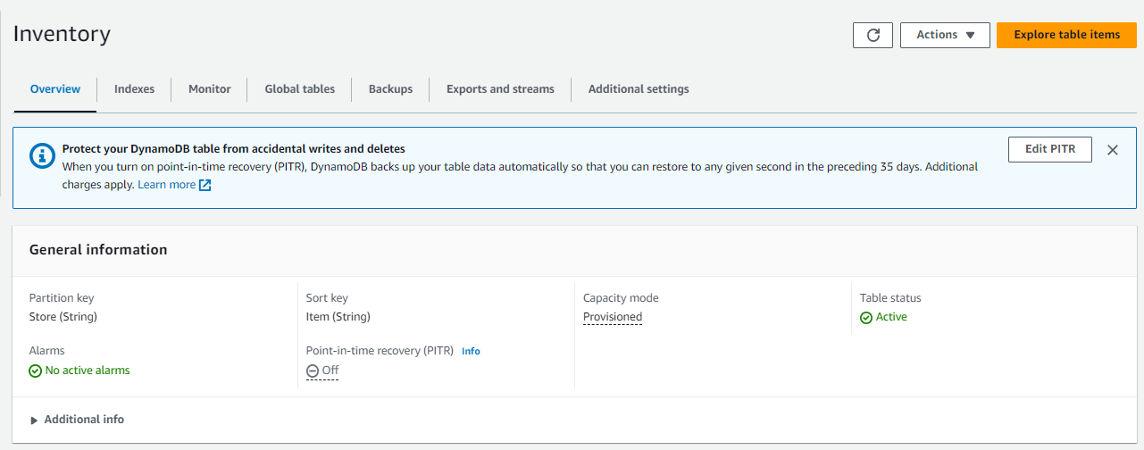
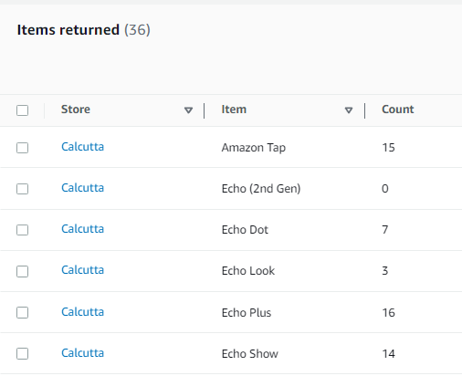
Go to dynamo db to visualize the data stored
On the Services menu, choose DynamoDB.
In the left navigation pane, choose Tables.
Choose the Inventory table.
Choose the Items tab. (Note: click on Explore Table Items

Slide 16
Task 4: Configuring notifications

Slide 17
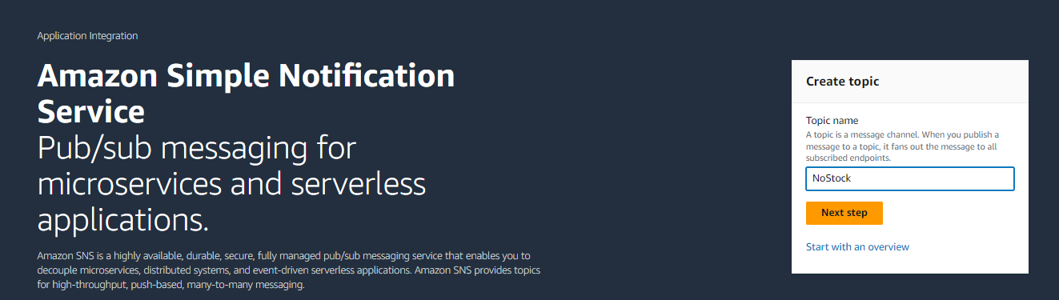
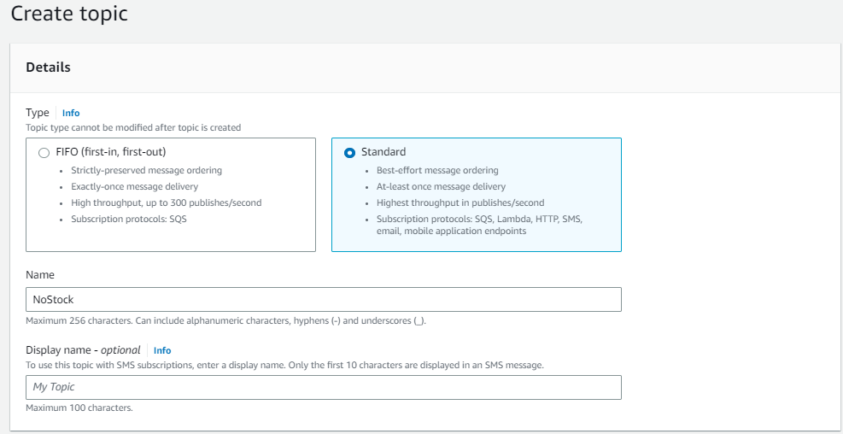
Open the sns console and create a new topic
n the Services menu, choose Simple Notification Service.
In the Create topic box, for Topic name, enter: NoStock. Keep Standard selected.
Choose Create topic

Slide 18
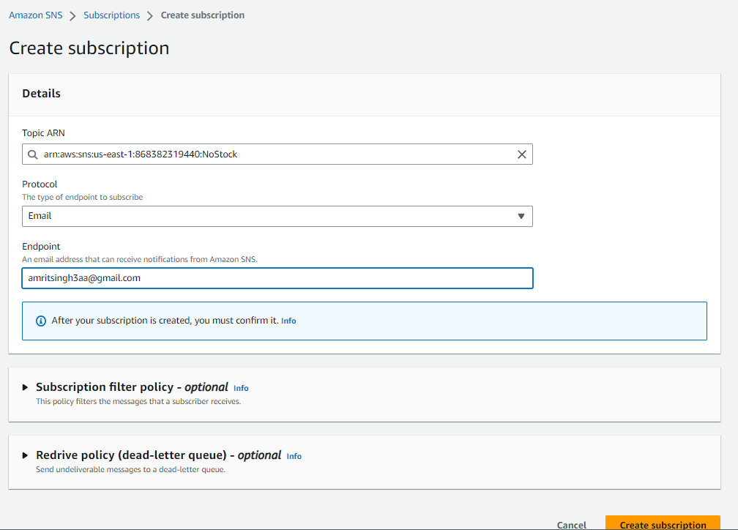
Chang ethe subscription settings and configure the following settings
In the lower half of the page, choose Create subscription and configure these settings:
Protocol: Email
Endpoint: Enter your email address
Choose Create subscription
After you create an email subscription, you will receive a confirmation email message. Open the message and choose the Confirm subscription link

Slide 19
Task 5: Creating a Lambda function to send notifications

Slide 20
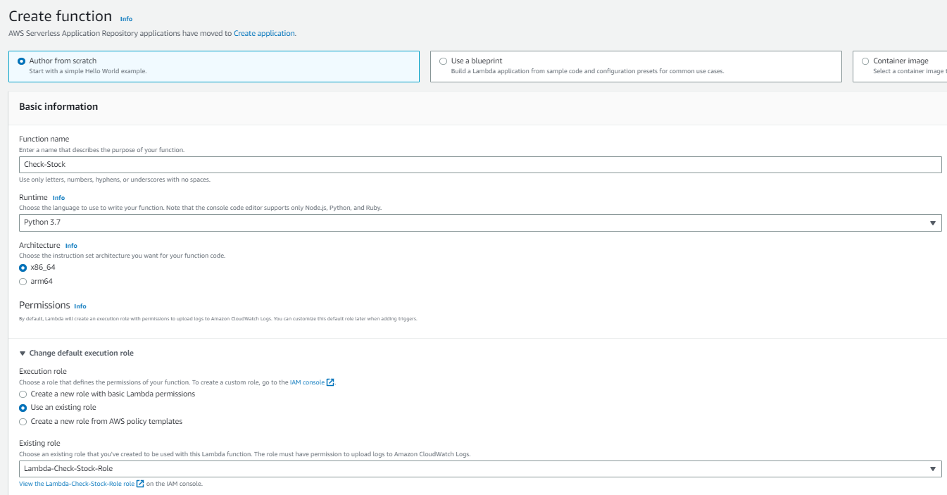
Return to the lambda console and create a new function
On the Services menu, choose Lambda.
Choose Create function and configure these settings:
Function name: check-stock
Runtime: Python 3.7
Expand Choose or create an execution role.
Execution role: Use an existing role
Existing role: Lambda-Check- Stock-Role
Choose Create function

Slide 21
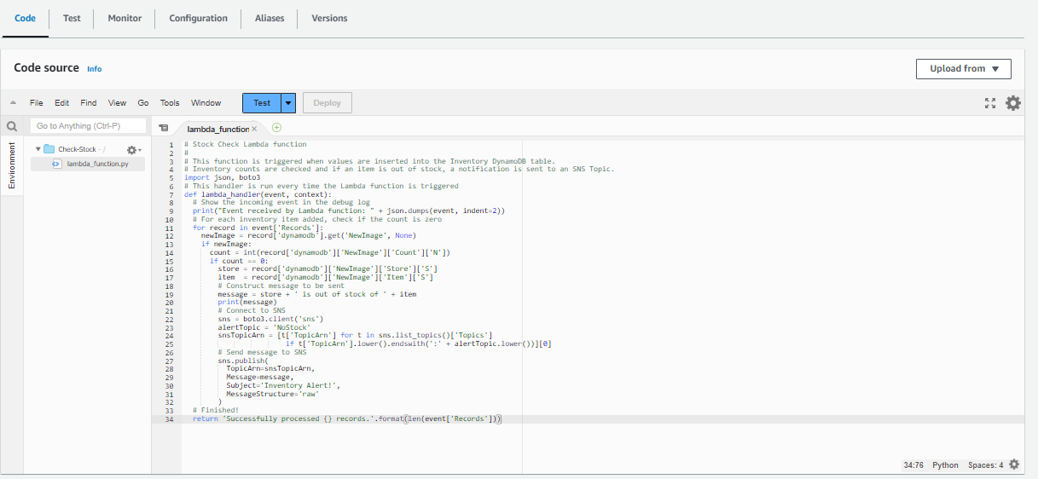
Change the code for the lambda function
Scroll down to the Code source section, and in the Environment pane, choose lambda_function.py.
In the code editor, delete all the code.
Copy the code from aws labs, and in the Code Source editor, paste the copied code
Choose Deploy to save your code changes

Slide 22
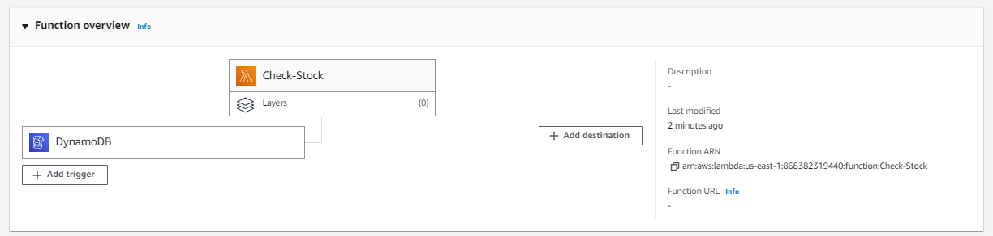
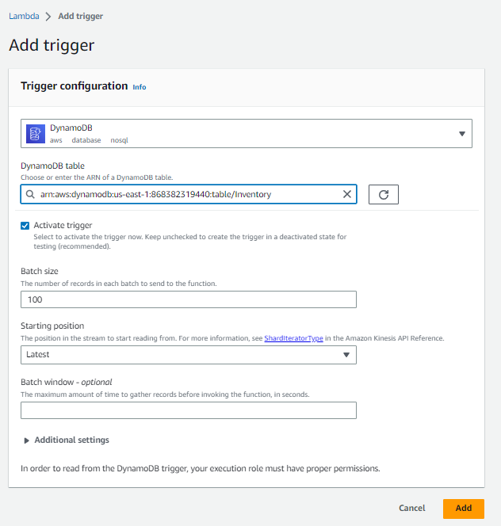
Scroll to the designer in lambda function
Scroll to the Designer section (which is at the top of the page).
Choose Add trigger and then configure these settings:
Select a trigger: DynamoDB
DynamoDB Table: Inventory
Choose Add

Slide 23
Task 6: Testing the System

Slide 24
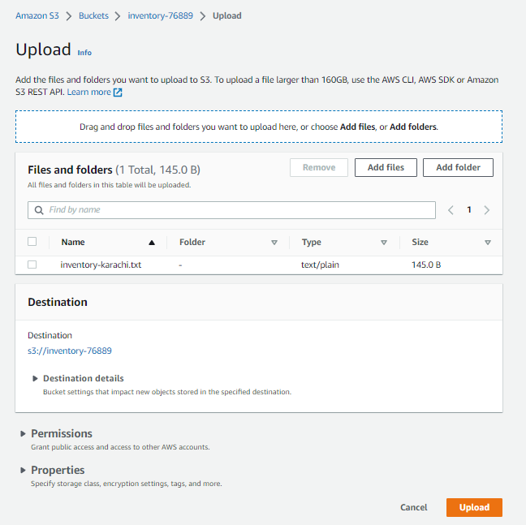
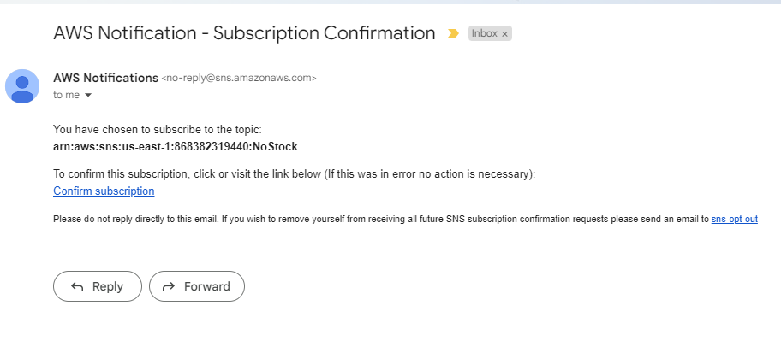
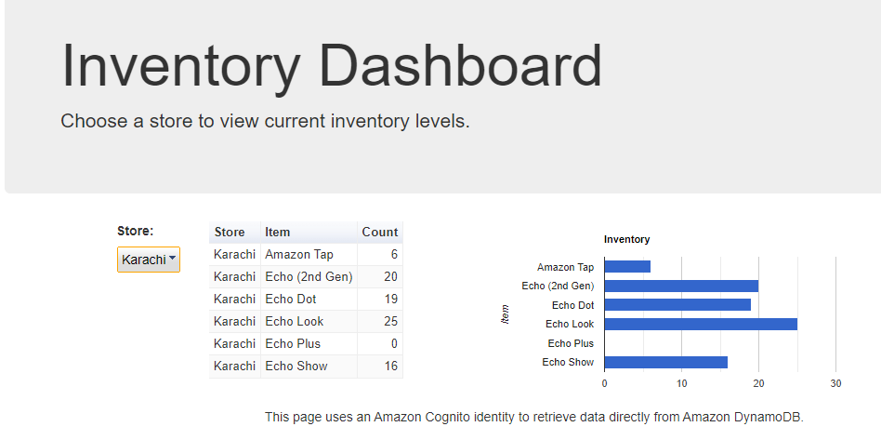
Go back to s3, and upload a new file
On the Services menu, choose S3.
Choose the name of your inventory- bucket.
Choose Upload and upload a different inventory file.
Return to the Inventory System Dashboard and refresh the page.
You should now be able to use the Store menu to view the inventory from both stores.

Slide 25
THANK YOU
Amrit Singh

